Slide 1
The Gene Ontology Project
Jane Lomax

Slide 2
2000
Notes:
The history of GO begins in 2000.

Slide 3
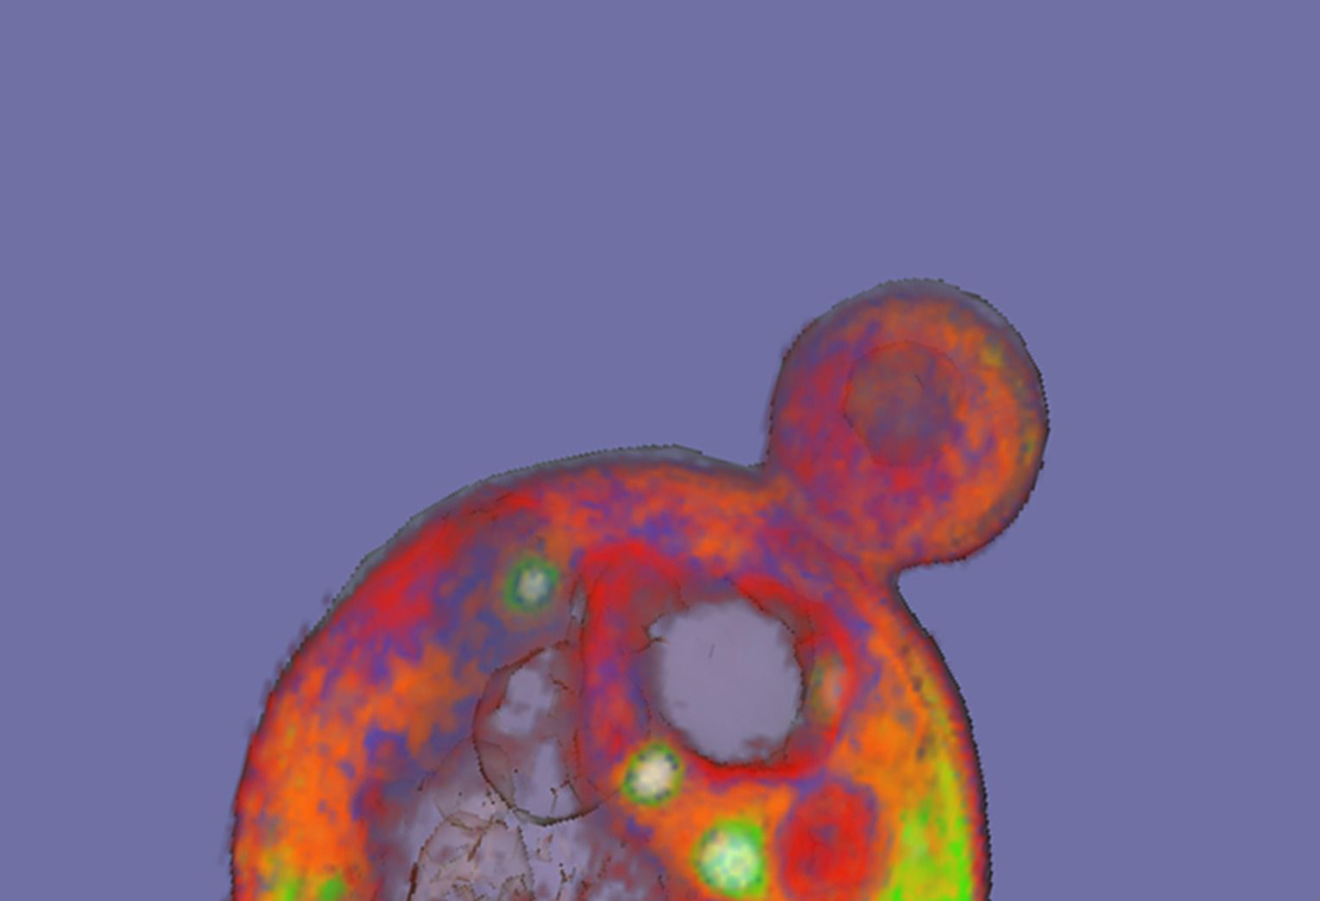
Model Organism Databases
Notes:
It was the era of model organism databases.
The databases were all annotating their genes and proteins, but using free-text to describe the function of those proteins.
A few of them got together and realised that there was a lot more power in their data if they used a common semantics for describing protein function.

Slide 4
Gene Ontology v1.0
Notes:
So Michael Ashburner went ahead and wrote the first version of the Gene Ontology
At the time no-one really knew what an ontology was, Michael just wanted to call it that to annoy some philosophers

Slide 5
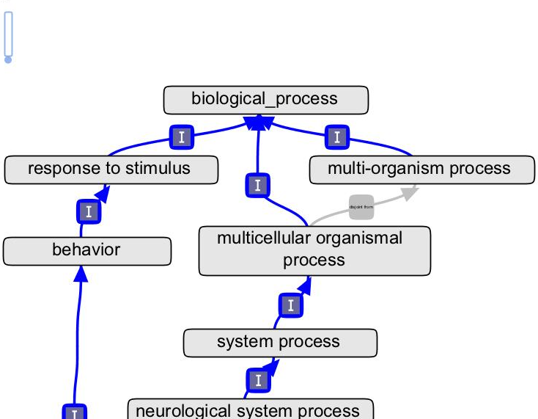
9000 terms
Notes:
It contained about 9000 terms or classes

Slide 6
2
relationships
Notes:
Linked in a hierarchy by two different relationships.
is_a and part_of
Format made up by MA

Slide 7
3
ontologies
Notes:
Split into 3 disjoint branches

Slide 8
normal processes, subcellular components and functions

Slide 9
Notes:
No defined semantics between gene and GO term in this model – we are in the process of moving to something more sophisticated
Evidence – which might be an assay – is separate to the

Slide 10
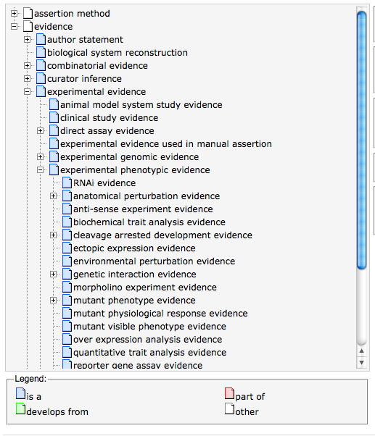
evidence
Notes:
The evidence for an annotation is separate from the ontology of real processes and components

Slide 11

manual
annotation
Notes:
Manually, from papers and sequence alignments

Slide 12
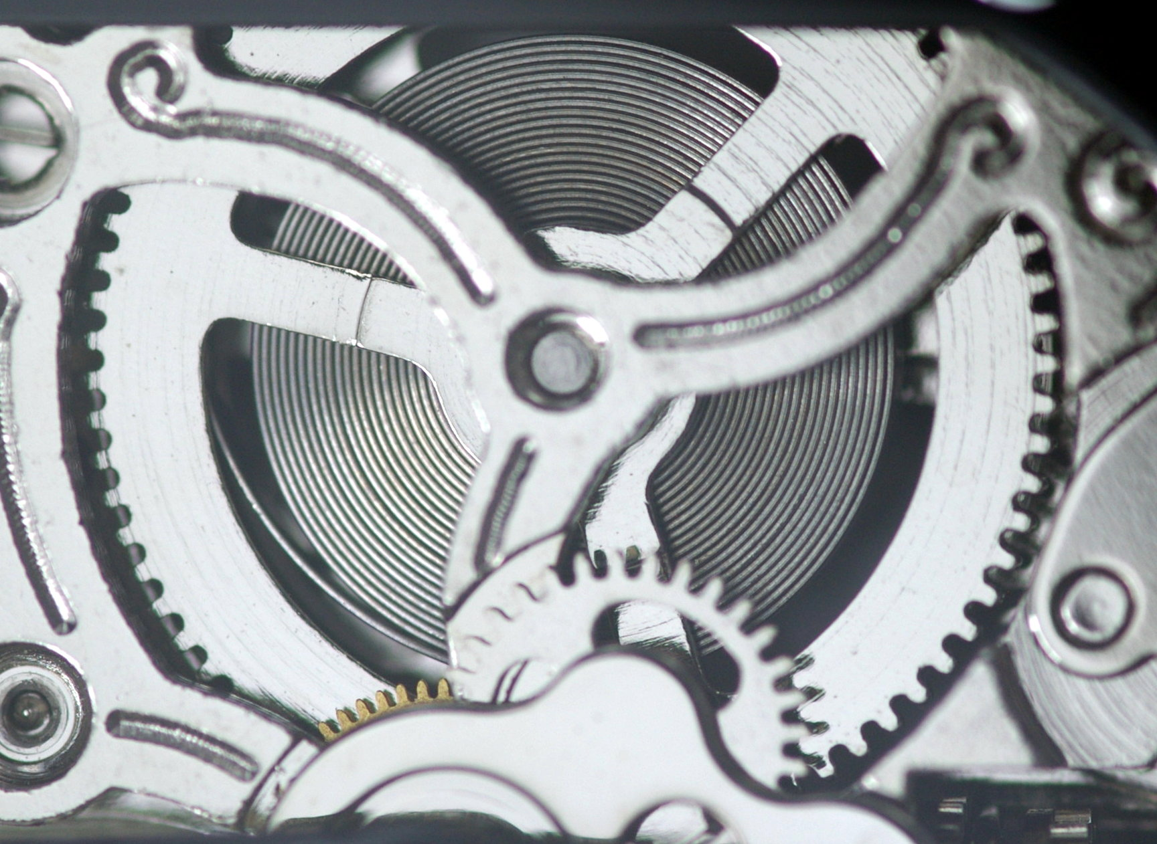
automatic annotation
Notes:
Electronically derived, by a whole series of different methodologies

Slide 13
GO database
gene -> GO term
associated genes
genome and protein databases
Notes:
The individual genome and protein databases submit their genes and proteins annotated to GO terms to a central GO database.
In turn consumed by many downstream tools

Slide 14
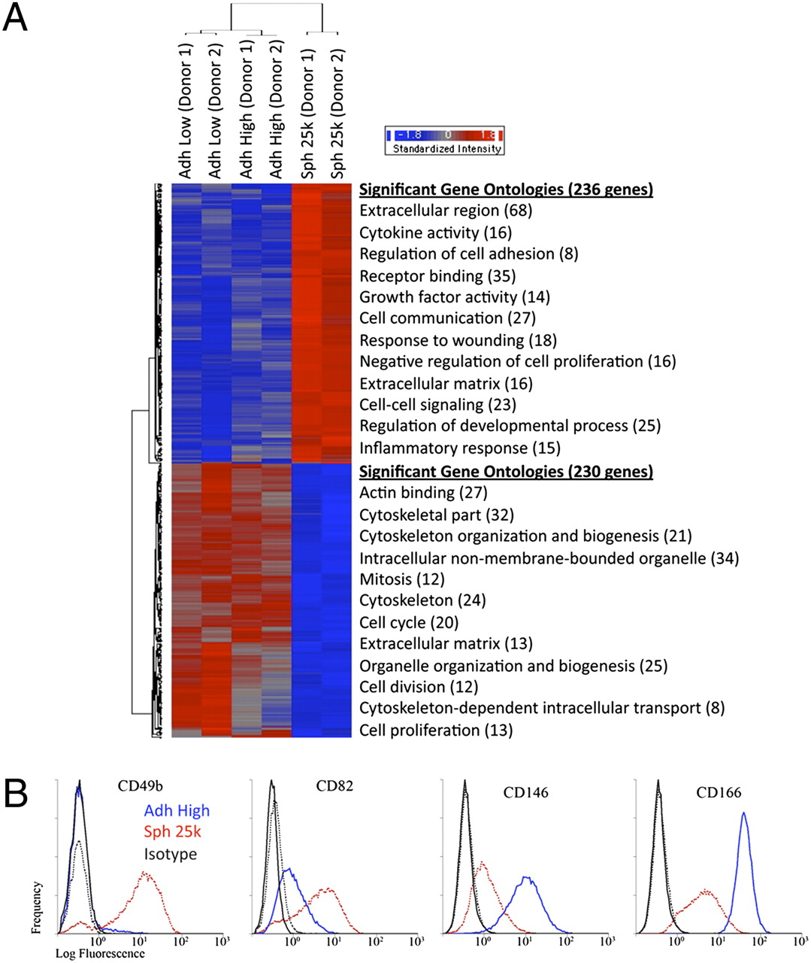
Microarray assays of hMSCs from two donors.
Bartosh T J et al. PNAS 2010;107:13724-13729
©2010 by National Academy of Sciences
Notes:
Microarray assays of hMSCs from two donors. (A) Hierarchical clustering of differentially expressed genes. Genes that were either up- (236 genes) or down-regulated (230 genes) in spheroids (Sph 25k) at least twofold compared with their adherent culture counterparts (Adh Low and Adh High), were used in hierarchical clustering. The most significant Gene Ontology terms for up-regulated genes (red) and down-regulated genes (blue) are shown next to the heat map. (B) Flow cytometry of differentially expressed surface epitopes on hMSCs. Abbreviations: as in Fig. 1.

Slide 15
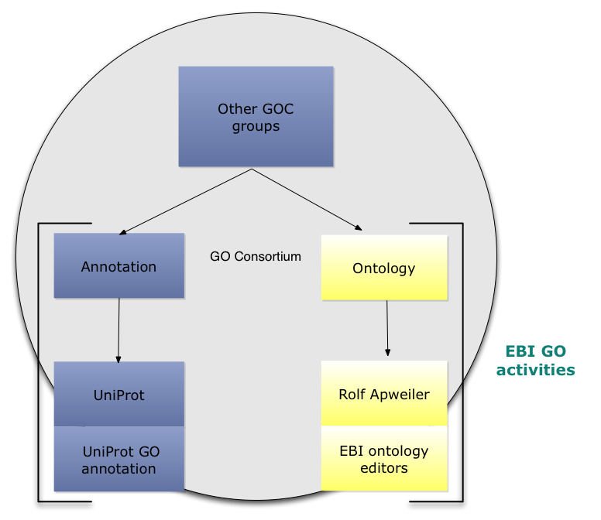
Notes:
From the outset, GO ontology development has been based here at EBI with a small ontology editorial team first with Michael Ashburner as PI, and now Rolf
UniProt – who joined the GOC shortly after its inception - also contribute a large proportion of it’s annotations.
All UniProt curators do GO annotation, and there are also several dedicated GO curators and a developer (formerly the GOA team)

Slide 16
2012
Notes:
So on to the current status…

Slide 17
funding
Notes:
GO has just received NIH funding for the next 5 years

Slide 18
Ontology
Formalization
Notes:
When GO started, it was a very simple ontology and this in many ways was an advantage: it allowed us to expand it very quickly in line with what was needed for annotation, without worrying too much about whether terms were in exactly the right place or what exactly they meant.
However, as GO got larger and more complex with new relationships and new branches, it became increasingly difficult to manage manually.
We realized we needed some automation to help out.

Slide 19
OWL v/s OBO
Notes:
Not a kung-fu style
GO has been developed in OBO format – a human-readable ontology format developed by the GOC
For a long time this worked okay. In tandem we also developed an ontology editor that reads OBO files called OBO-Edit.
OWL – the Web Ontology Language – is a language for representing ontologies with more formal semantics and allow the use of semantic reasoners - a piece of software able to infer logical consequences from a set of asserted facts or axioms.
It became clear that we needed the reasoning power that these reasoners could provide, and when the mappings between OBO and OWL became advanced enough, we were able to switch over to an editing model where we go between the formats, reasoning in OWL/Protégé and editing in OBO/OBO-Edit

Slide 20
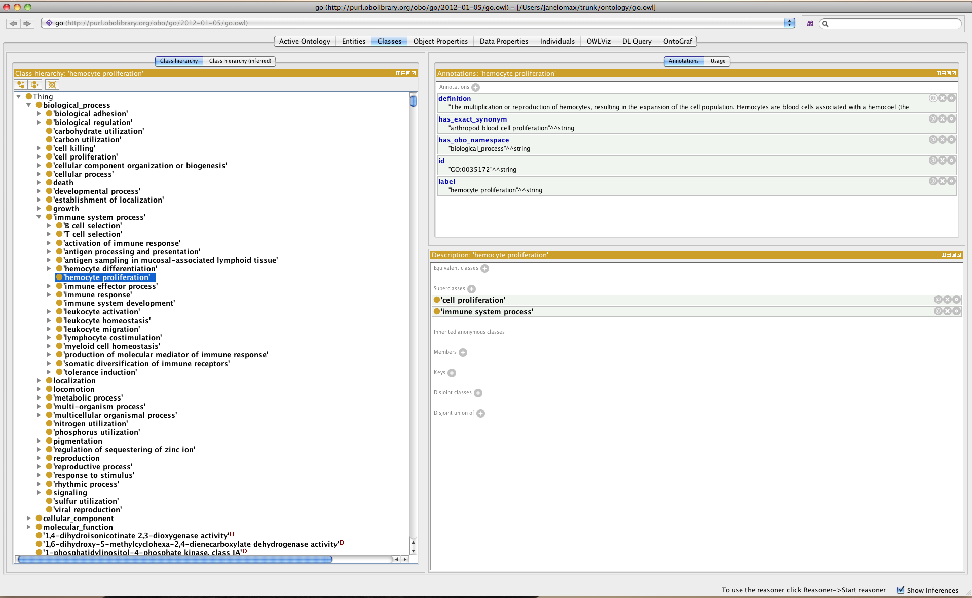
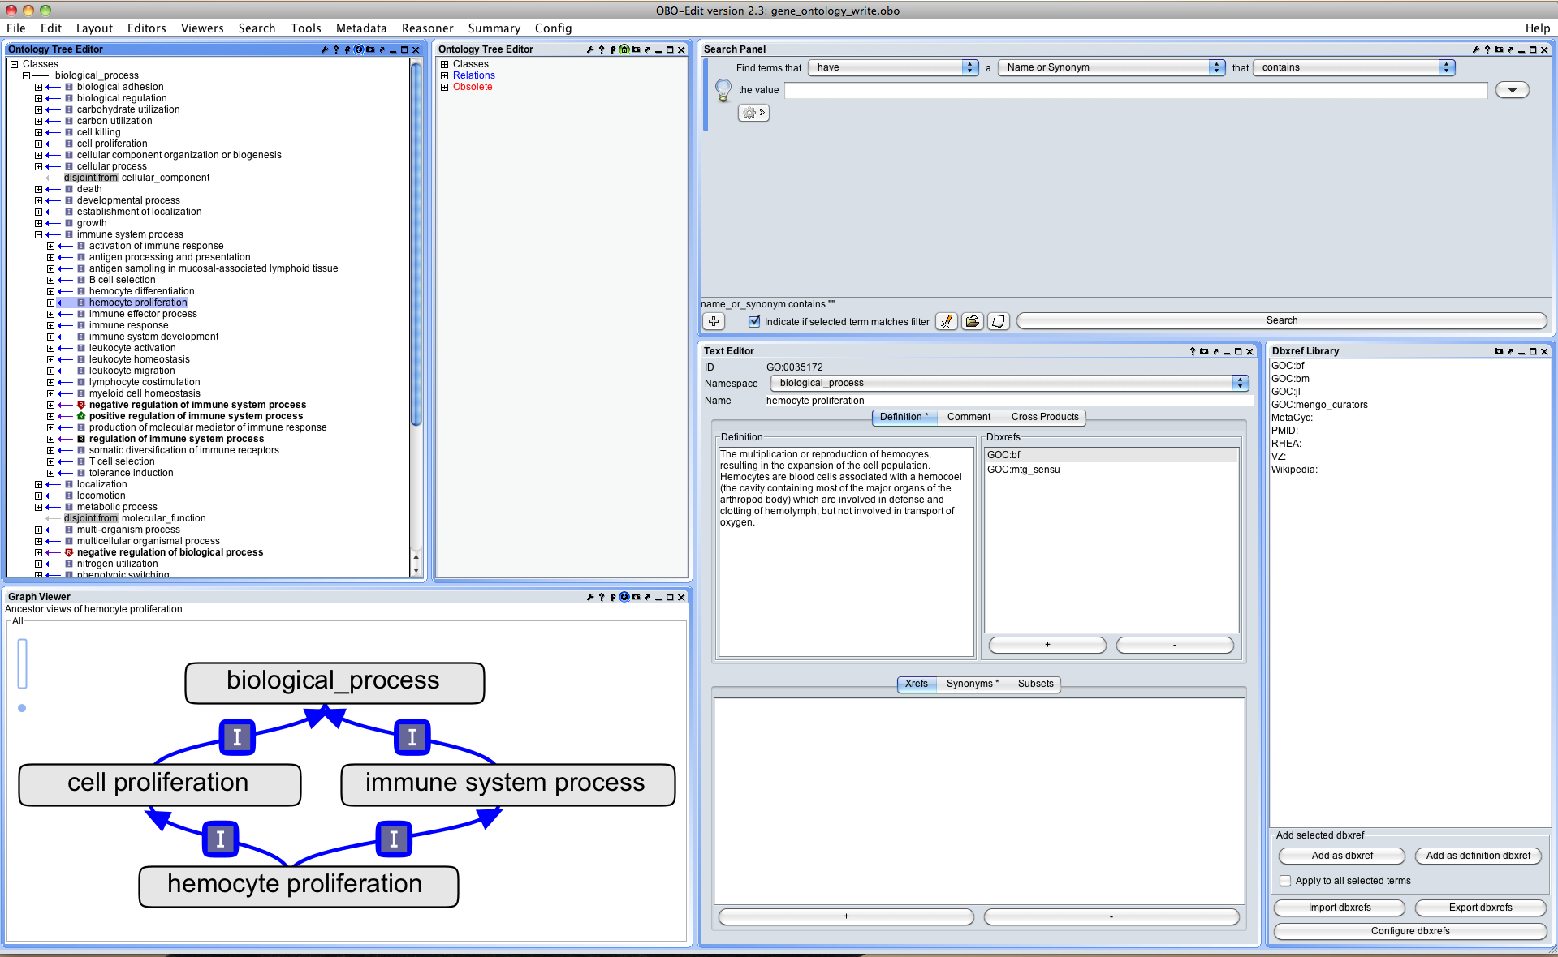
Protégé 4
OBO-Edit 2.3
Notes:
It would more sense to switch over to working in OWL completely:
reasoning instantaneous
OBO->OWL lossy
The problem is the editing interface of Protégé isn’t well-developed: no good graphical interface, editing metadata poor
So OBO-Edit good for editing, Protégé good for reasoning.
If and when Protégé improves, we probably switch make a permanent switch.
BUT GO will always be distributed as OBO as well

Slide 21
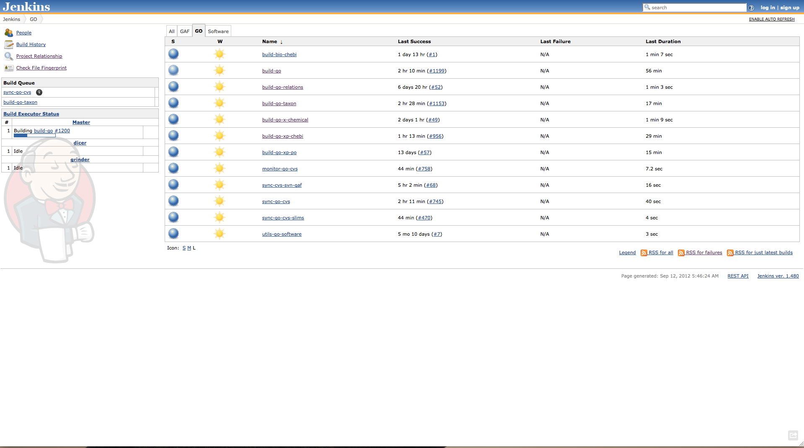
continuous integration
Notes:
But this editing model has actually lead to some pretty cool innovations
This is probably familiar to software developers, but we use a system of continuous integration for our ontology development. Every time a change is made to the file, a series of checks are run:
- logical checks – no classes inferred to be equivalent, no unsatisfiable classes
- various syntactic and format checks
Jenkins is a generic platform for continuous integration – when the build fails for any reason, the ball becomes red and the more red balls, the worse the weather gets!
The reason this is important for GO is that we rely on a lot of external ontologies and bridging files and we need these to remain logically consistent

Slide 22
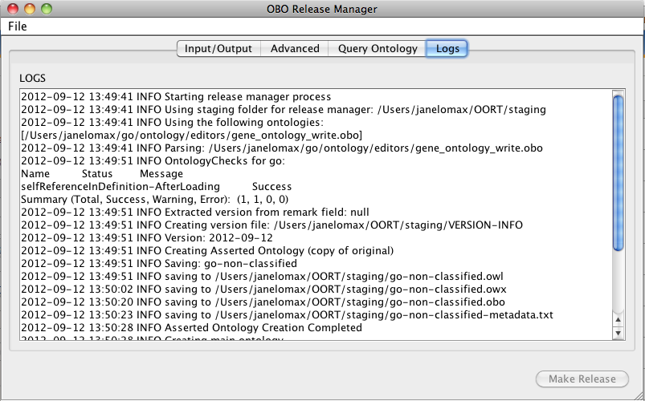
Oort
http://code.google.com/p/owltools/wiki/Oort
Notes:
The Jenkins platform calls up another tool – Oort, the OBO release manager
Oort is a build tool for ontologies – you feed it an ontology, OBO or OWL and it runs various ontology unit tests and it creates releases.
Uses the OWL API so can use most OWL reasoners

Slide 23
simple
full-GO
subsets (aka slims)
OWL
http://www.geneontology.org/GO.downloads.ontology.shtml
Notes:
One of the other ways we use Oort is to create all of the different ‘cuts’ of GO
The main editing version of GO is fairly rich in terms of logical constraints, relationship types etc and is pretty large.
Not all users need this level of complexity or detail, so we use Oort to generate a simple file, with only a few relationship types and no logical definitions, various subsets – GO slims as well as the OWL version of GO

Slide 24
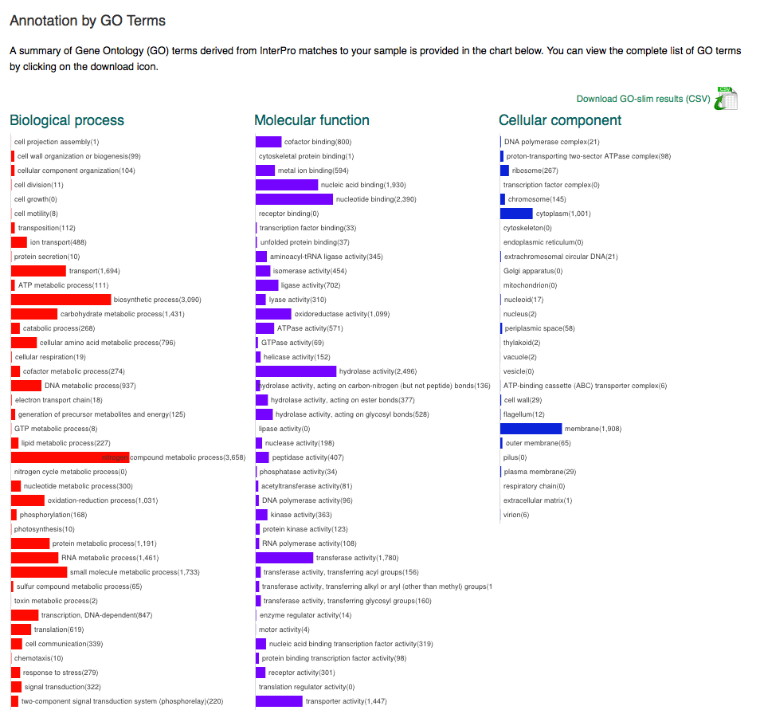
GO slims
Notes:
Metagenomics GO slim developed with InterPro

Slide 25

TermGenie
Notes:
One of the bottlenecks we have is that all terms need to be added by a small group of ontology developers
To help ameliorate this, we have developed a system for adding new terms that conform to specific templates.
Called TermGenie because the prototype versions used to say “your request has been granted”

Slide 26
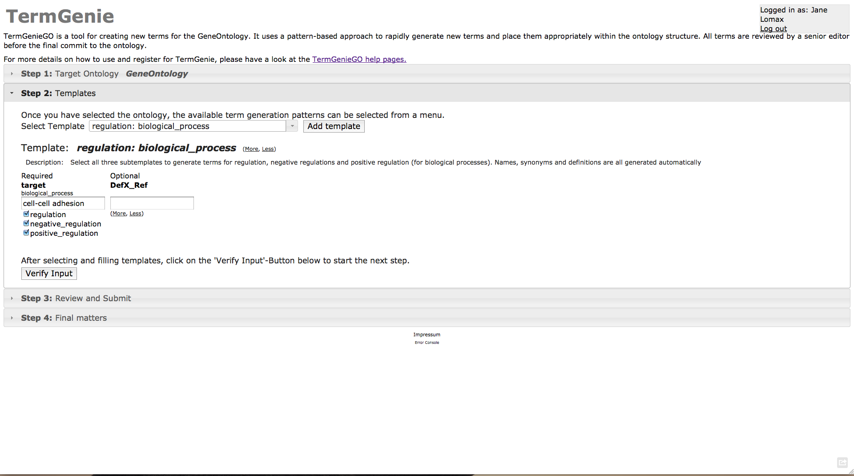
http://go.termgenie.org/
Notes:
Users are given a login and choose a specific template.
They build the term they need based on existing terms. The term is placed in the ontology based on its logical constraints.
Users are given an id for their new term immediately.
Terms are given a final review by an expert curator and then deployed directly in to the ontology.
If it’s a bad term (unusual if it conforms to a template) it’s obsoleted in the usual way.

Slide 27
taxon constraints?

Slide 28
Annotation extensions
Notes:
Or column 16 as it’s somewhat more mysteriously known.
this has arisen from the frustration of annotators working with the simplistic annotation model.
There are some pieces of information that are not easily captured in the current GO annotation model, so an annotation extension was created whereby
So you can make a statement e.g. gene product X is involved in apoptosis in cell type Y
The extension have defined semantics and allow a large range of additional information to be captured
But many things are still not possible e.g annotation lines are unrelated statements – you can say the same gp participates in a process and is located in a given cell component but not that those things happen together

Slide 29

OWL v/s OBO
Notes:
Which leads me on to the future

Slide 30
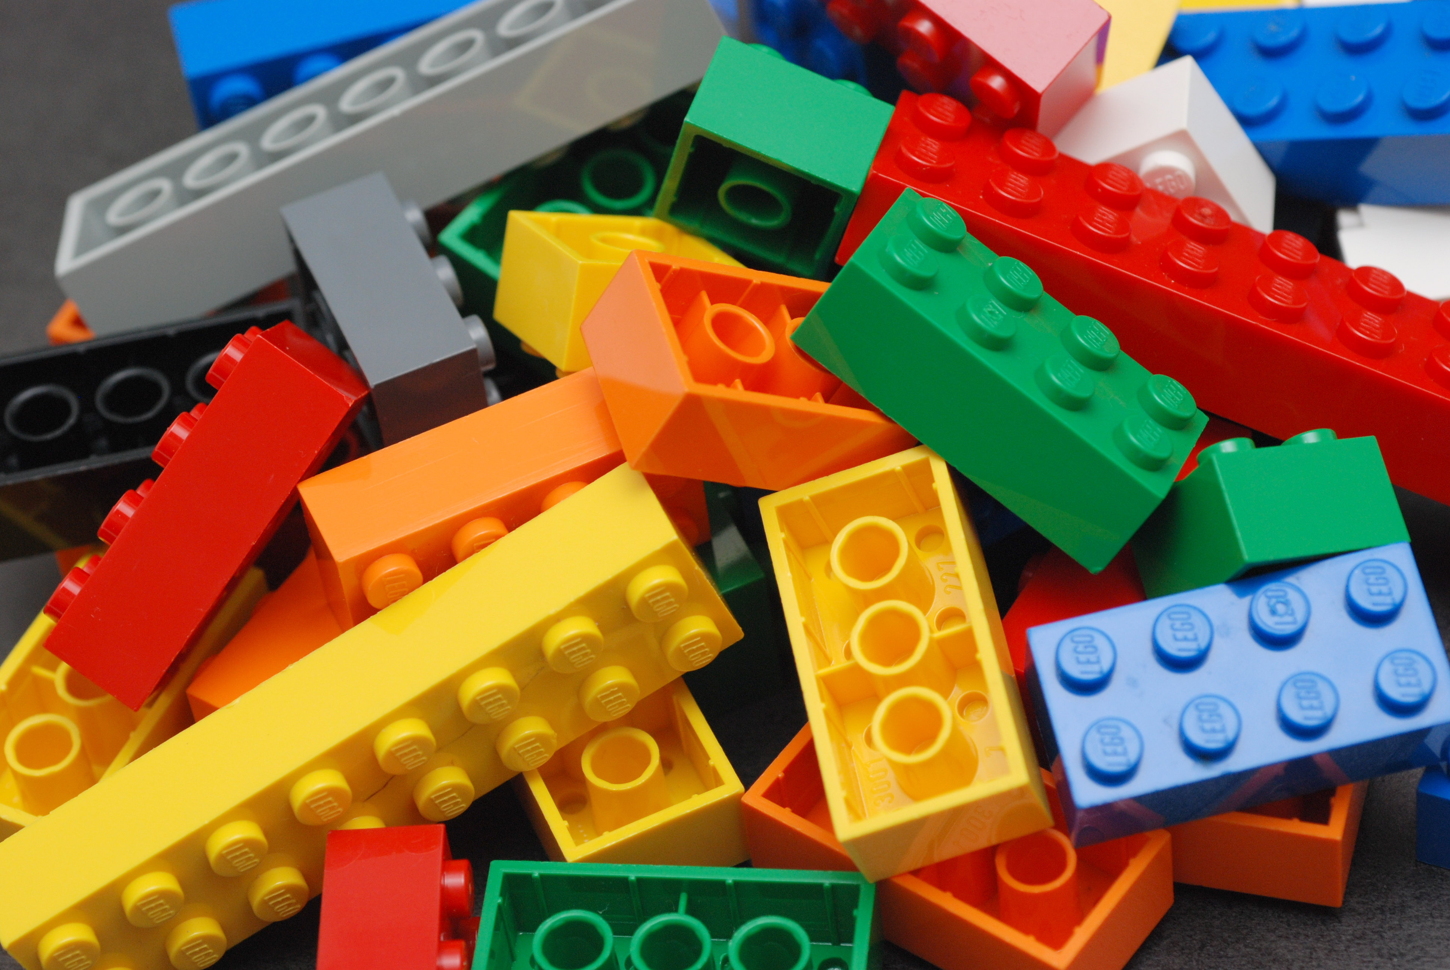
new annotation model
Notes:
One of the projects we’ve been working on is an enhanced annotation model, which has the working name LEGO because it by a series of modular blocks that can be fitted together

Slide 31
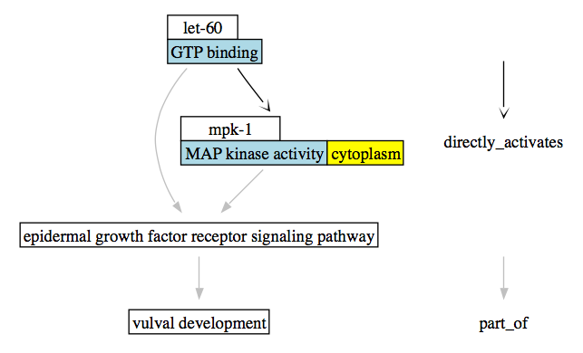
Notes:
This is an example from C. elegans
So the idea is that an annotator builds up a picture, or story of the biological events at the level of the individual proteins
The terms in blue are the ontology terms.

Slide 32
Common Annotation Framework
Common toolset for annotation submission
RuleBase for annotations
syntax errors
taxon contraints
Annotation tool for annotating groups who need it
Based on EBI’s protein2go?

Slide 33
Ontology Future
Continue to add axioms to GO
Expand TermGenie capabilities
Complete transition to OWL?

Slide 34
Integration with other ontologies
CHEBI
Cell Ontology (CL)
Anatomy Ontologies (Uberon?)
Sequence Ontology (SO)
Behaviour/Mental Functioning Ontologies (NBO/MFO)
Infectious Disease?
Population processes?

Slide 35
Enzymes
Automatic pipeline for adding catalytic reactions from RHEA to GO molecular function

Slide 36
Rolf Apweiler
Rebecca Foulger
Paola Roncaglia
Susan Tweedie
Rachael Huntley
Tony Sawford
Prudence Mutowo
Yasmin Alam-Faruque
Mike Cherry
Suzi Lewis
Paul Thomas
Paul Sternberg
Judy Blake
Chris Mungall
Heiko Dietze
David Hill
Tanya Berardini
Harold Drabkin
+ the rest of the GO Consortium

