Slide 1
Bridging GO, Uberon and multiple species specific anatomy ontologies

Slide 2
Uberon
embryo
P
somite

Slide 3
x-metazoan-anatomy
embryo
development
embryo
P
P
somite development
somite
These axioms to move into editors file “megafile”

Slide 4
ssAOs
ZFA:embryo
P
ZFA:somite
ZFA:somite 1
…
ZFA:somite 29

Slide 5
ssAOs
ZFA:embryo
We would avoid having
this in uberon – “number 29”
Isn’t a useful cross-species
Grouping (though initial and
Terminal might be)
P
ZFA:somite
ZFA:somite 1
…
ZFA:somite 29

Slide 6
ssAOs
EMAPA:embryo
P
EMAPA:somite group
EMAPA:somite 1
…
EMAPA:somite 60

Slide 7
How are these ontologies bridged?
Uberon collector ontologies
  Collected mammal
  Collected verterbrate..
Uberon composite ontologies
  Composite vertebrate
  Composite metazoan
Each make use of bridge ontologies
  E.g. http://purl.obolibrary.org/obo/uberon/bridge/uberon-bridge-to-fbbt.owl

Slide 8
Uberon/bridge/collected-vertebrate
embryo
ZFA:embryo
P
somite
P
ZFA:somite
Uberon/
Bridge-to-zfa
ZFA:somite 1
…
ZFA:somite 29

Slide 9
Unique labels
embryo
ZFA:embryo
Obo-unique-label: embryp (zebrafish)
P
somite
P
ZFA:somite
Obo-unique-label: somite (zebrafish)
Uberon/
Bridge-to-zfa
(this also has
The unique
Labels)
ZFA:somite 1
Obo-unique-label: somite 1 (zebrafish)
…
ZFA:somite 29
Obo-unique-label: somite 29 (zebrafish)

Slide 10
Multi-ontology Lattice hell
embryo
EMAPA:embryo
ZFA:embryo
P
P
somite
EMAPA:somite group
P
ZFA:somite
(in practice, uberon
Has an extra level of
Grouping e.g. ‘head somite’,
Not shown here)
EMAPA:somite 1
EMAPA:somite 60
ZFA:somite 1
…
ZFA:somite 29

Slide 11
Composite-vertebrate
Embryo
Xref: ZFA:embryo
X
ZFA:embryo
P
Somite
Xref:ZFA:somite
P
ZFA:somite
ZFA:somite 1
…
ZFA:somite 29

Slide 12
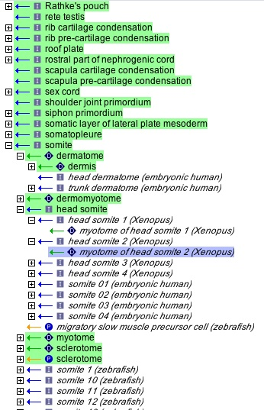

Slide 13
GO logical defs use composite-metazoan
Imaginal disc imorphogenesis
Uberon:imaginal disc
Xref:FBbt:imaginal disc
I
I
clypeo-labral disc morphogenesis
FBbt:clypeo-labral disc

Slide 14
Composite uberon in GO
Imaginal disc imorphogenesis
Uberon:imaginal disc
I
I
clypeo-labral disc morphogenesis
FBbt:clypeo-labral disc
Although this term could be generalized beyond Dmel, the strategy so far
In uberon has been to leave these alone and only include very specific classes for
vertebrates. Whilst it would be great to use GO to annotate a wide range of arthropods, in practice Dmel is the only one with data, so using FBbt is fine here.
We leave open the door for generalization (Arthropod ontology?)

Slide 15
Anatomy and c16
GOA use Uberon for:
  Human, chicken, cow, …
    No need to incur cost of bridge ontologies
    Uberon is fairly extensive and extensible for these species
ZFA – no c16 yet
FB – no c16 yet
  Recommend use of FBbt
    Use bridge ontologies behind scenes for reasoning
WB – recommendations as for FBbt
  WBbt may need a bit of work to conform to common standards
Mouse…..

Slide 16
Mouse
There are 3 ontologies
  MA – adult (isa + part of)
  EMAP – embryonic staged (partonomy)
  EMAPA – embryonic abstracted
Current c16:
  MA + EMAP
    Requires double-bridging for embryo (EMAP->EMAPA->Uberon)!!
New c16:
  MA + EMAPA
    This is better, more tractable
    Still requires use of collected ontology (lattice hell) rather than composite ontology (generic terms merged in)
Complications:
  Some mouse annotation done by GOA
  They will use Uberon
Conceivably Uberon could be used for mouse
  Uberon is v detailed for mammals
  This would simplify things

Slide 17
Import chain hell
Which ontology to use?
  For ontology work, use composite-metazoan
  This avoids lattice hell
    E.g. only one somite, one brain, one heart, …
  For GAFs, it depends on species
    For many, plain uberon is fine
    For others, collected must be used
      This is because the group will use the ssAO for all c16 annotations in that species, regardless of whether the generalized form exists in uberon

Slide 18
CL
CL is analogous to uberon
In practice, GO has less invertebrate-specific terms at the cell-type level, so often use of CL is sufficient

Slide 19
What about plants and fungi?
Uberon and CL are metazoan
Plants: PO
Fungi: FOA (needs a caretaker)
Not much overlap with metazoan
  Used to be ‘fake’ overlap in GO – e.g. ‘epidermis’
Grouping is generally at CARO level
  Btw, GO’s “organ” and “tissue” is often not the same as other ontologies…

