Slide 1
A marriage of chemistry and biology
Aligning the Gene Ontology with CHEBI

Slide 2
ontologies: what are they really for, and why do I care?

Slide 3
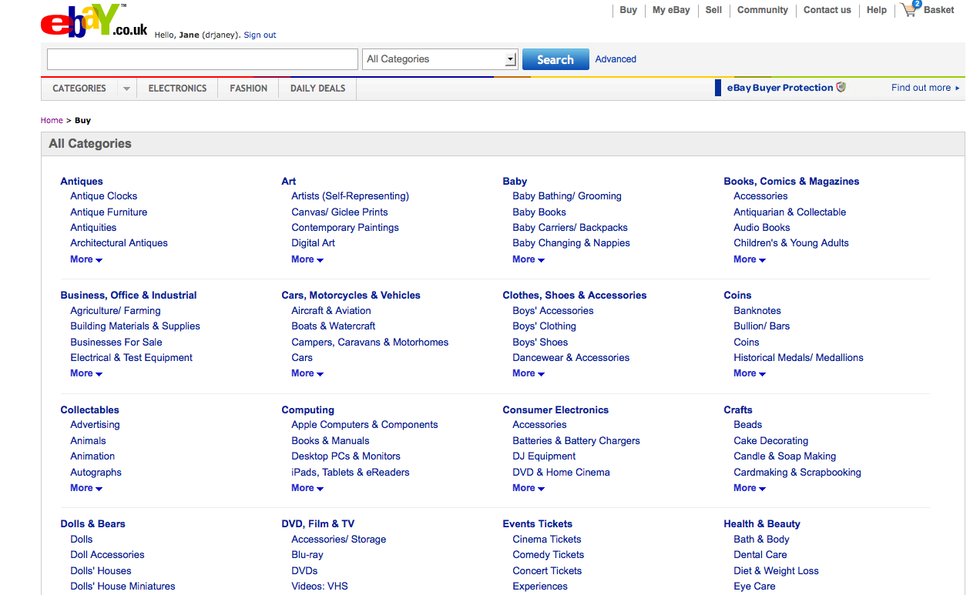

Slide 4
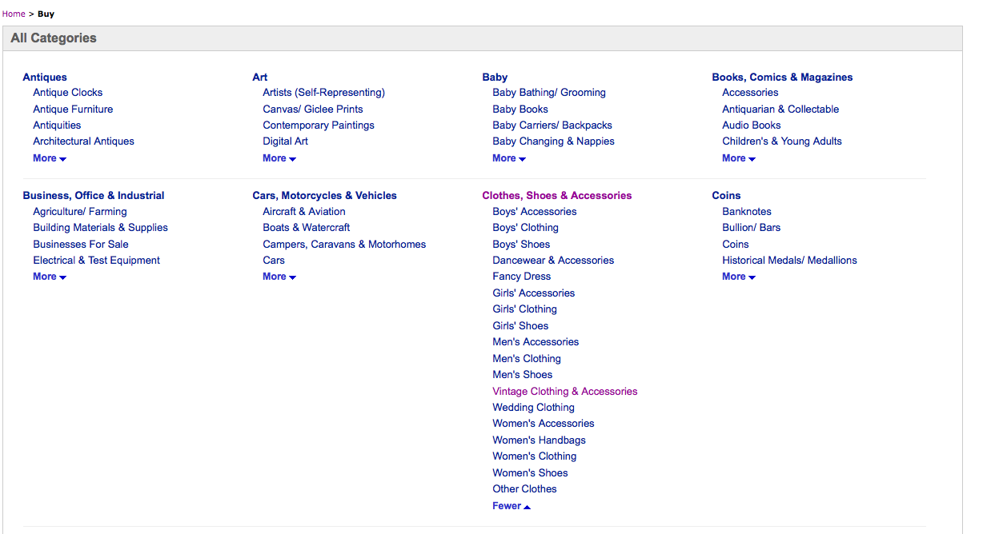

Slide 5
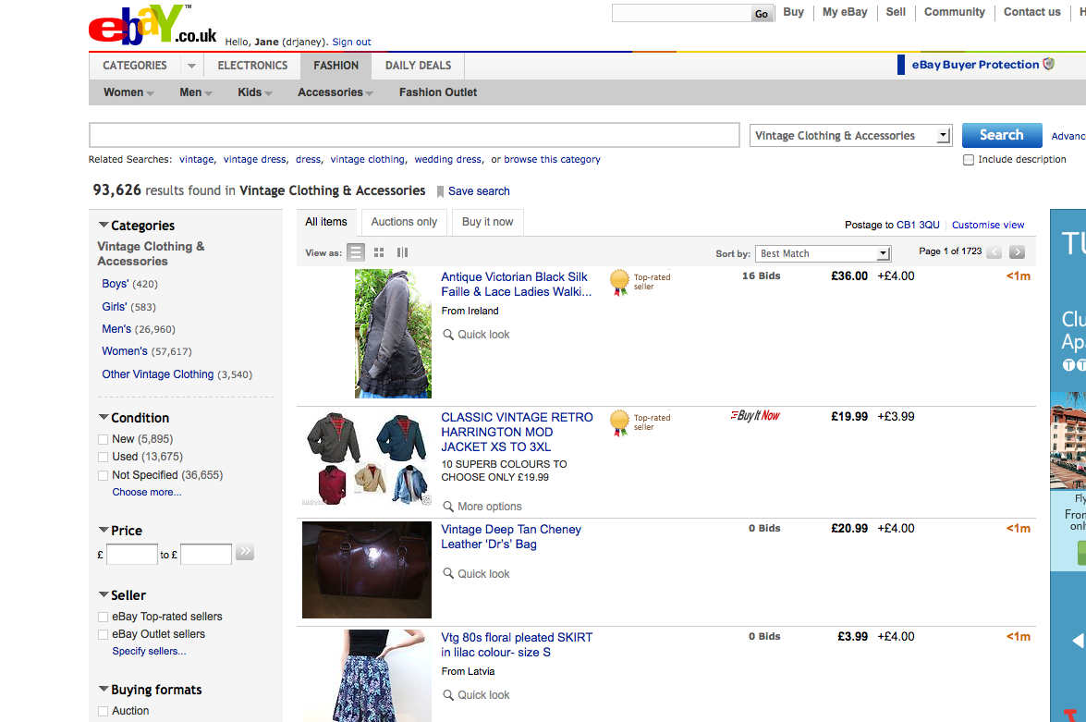

Slide 6
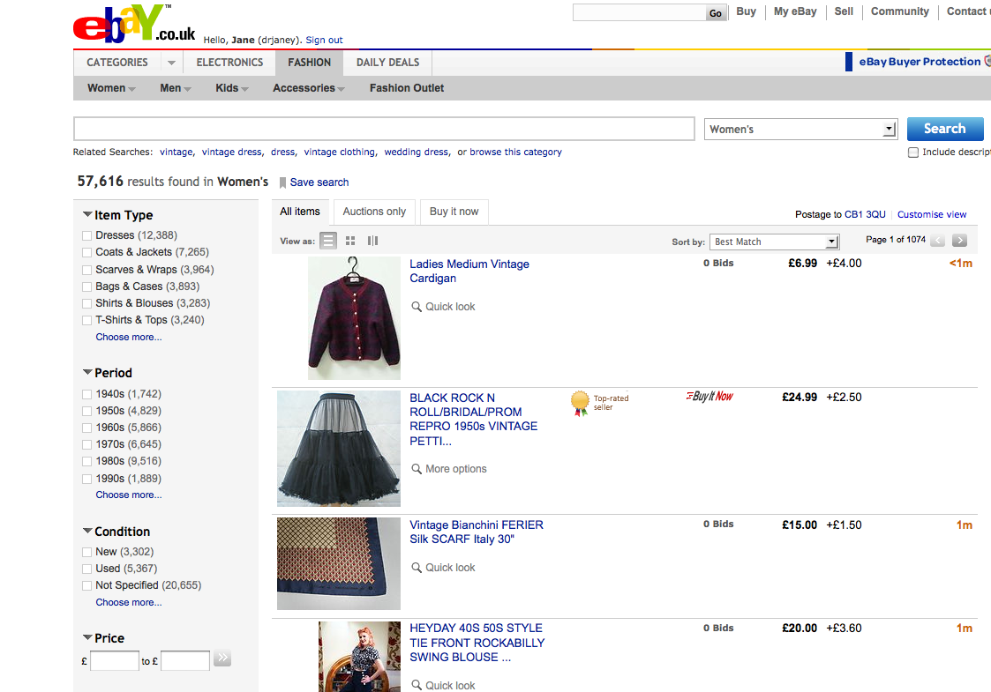

Slide 7
systems of categorization, useful for handling large amounts of data
Notes:
ideal for biology

Slide 8
Gene Ontology arose from a need to classify functional data about genes and proteins in various databases

Slide 9
Parallel efforts grew up elsewhere

Slide 10



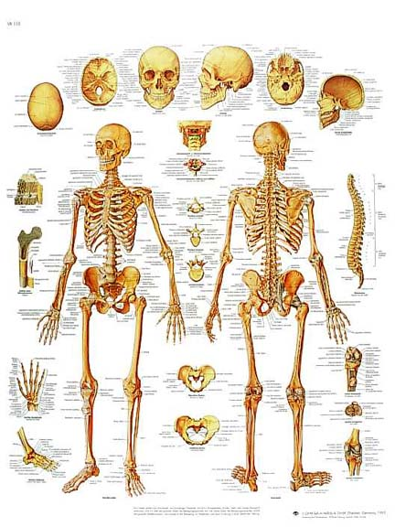
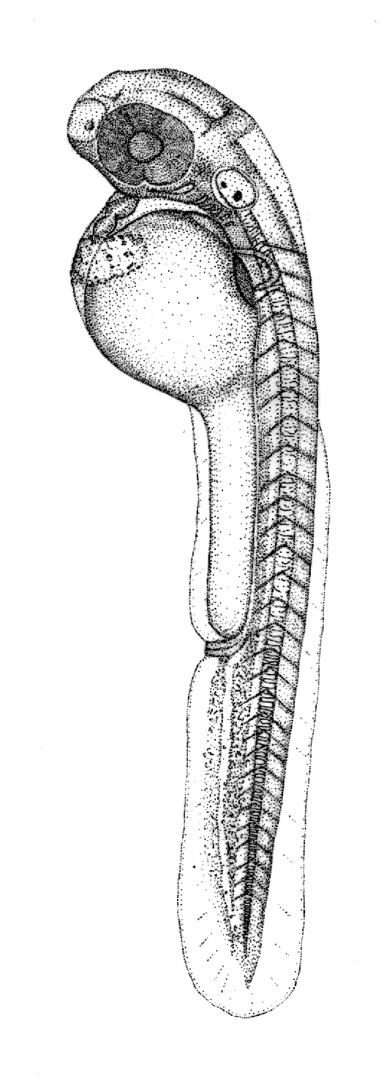


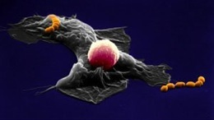
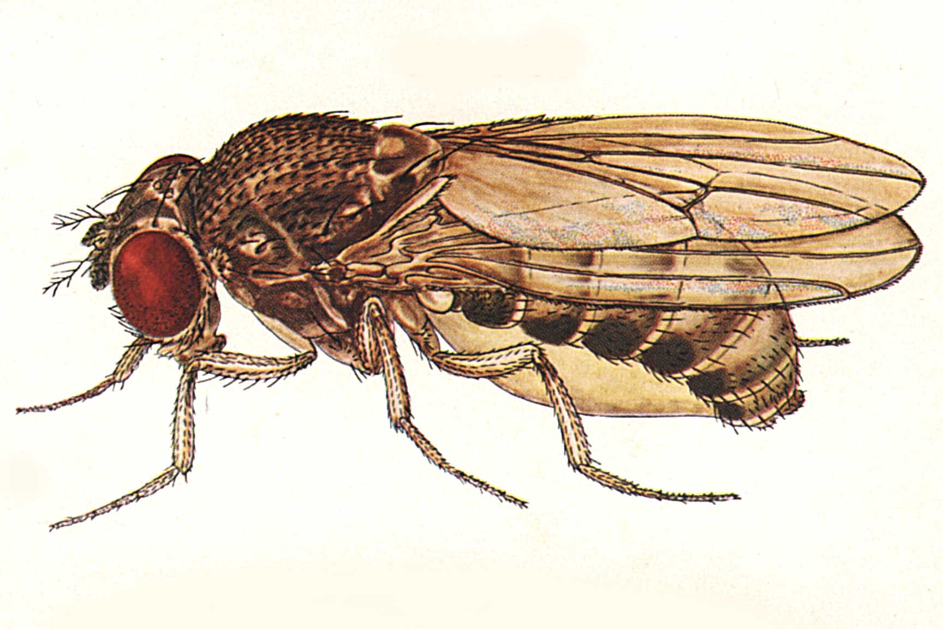


Slide 11
GO has always contained a chemical hierarchy

Slide 12
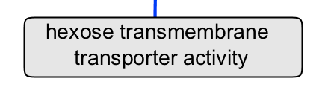
Roncaglia

Slide 13
Roncaglia

Slide 14
Roncaglia

Slide 15
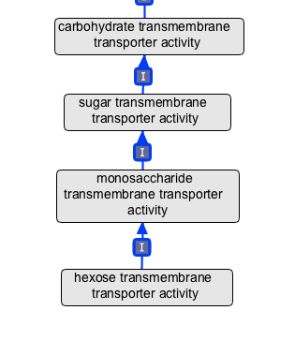

Slide 17
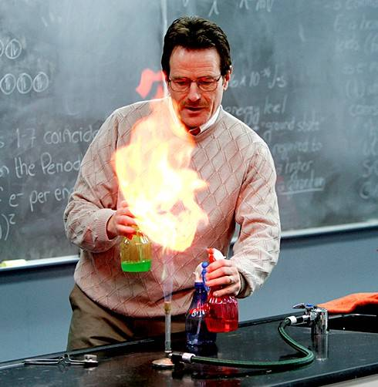
biologists are not great chemists

Slide 18
Use CHEBI to make chemical hierarchy in GO

Slide 19
The story begins in 2009 when we decided to get started. We figured it would take a few months.

Slide 20
GO terms were ‘decomposed’ and text-matched to ChEBI terms

Slide 21
A few technical issues needed to be sorted out with the relationships in CHEBI first

Slide 22
Once that was done, we generated a list of mismatches between GO and CHEBI

Slide 23
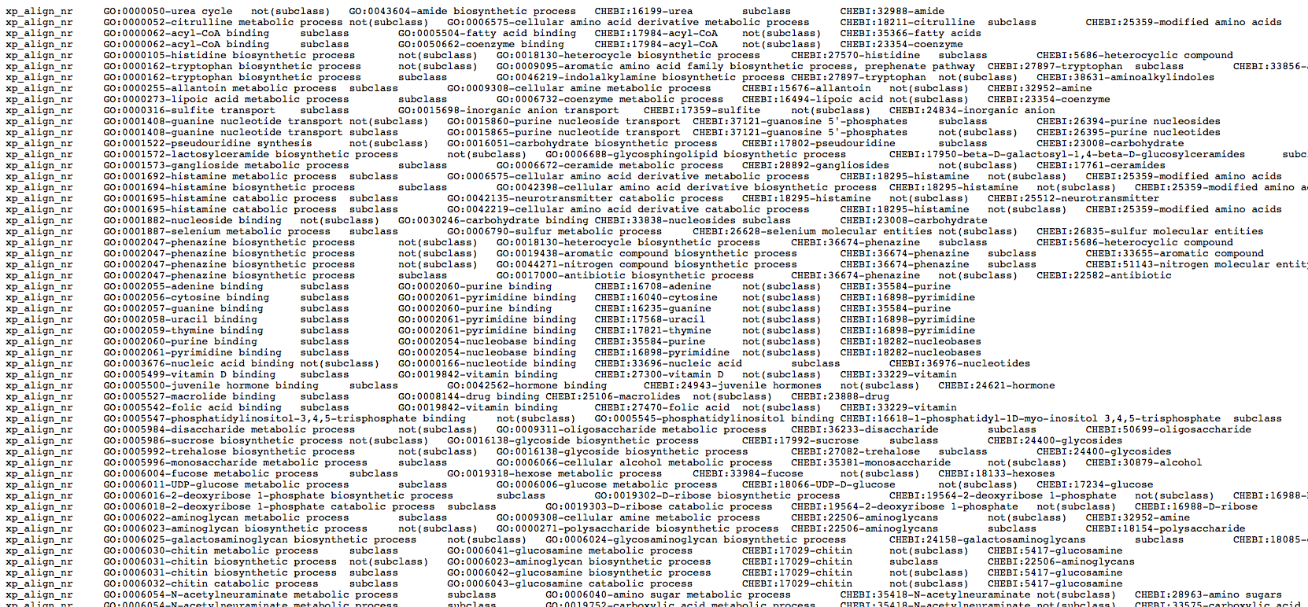
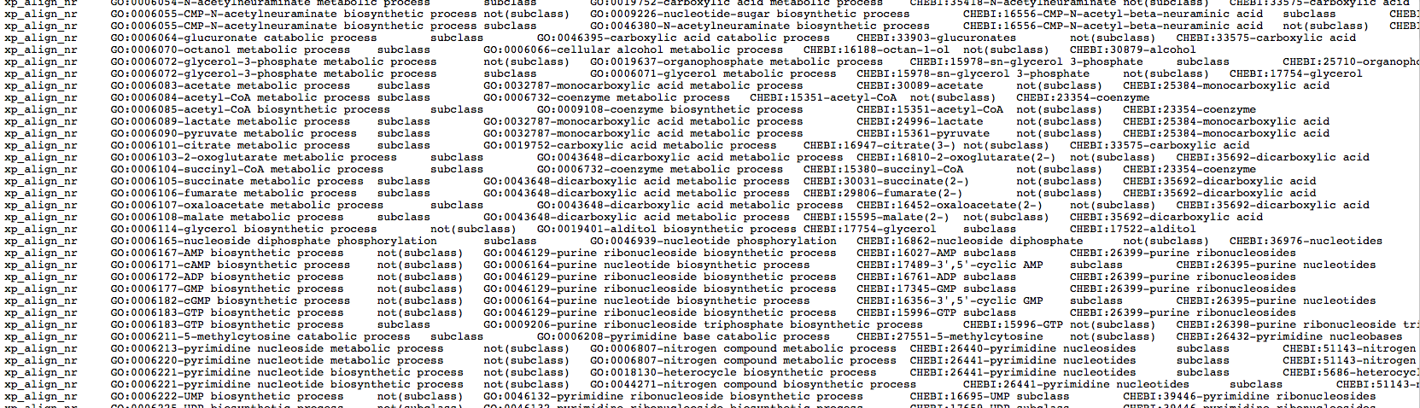

Slide 24
One of the first things we realized was that we weren’t even consistent with our chemical classification with ourselves

Slide 27
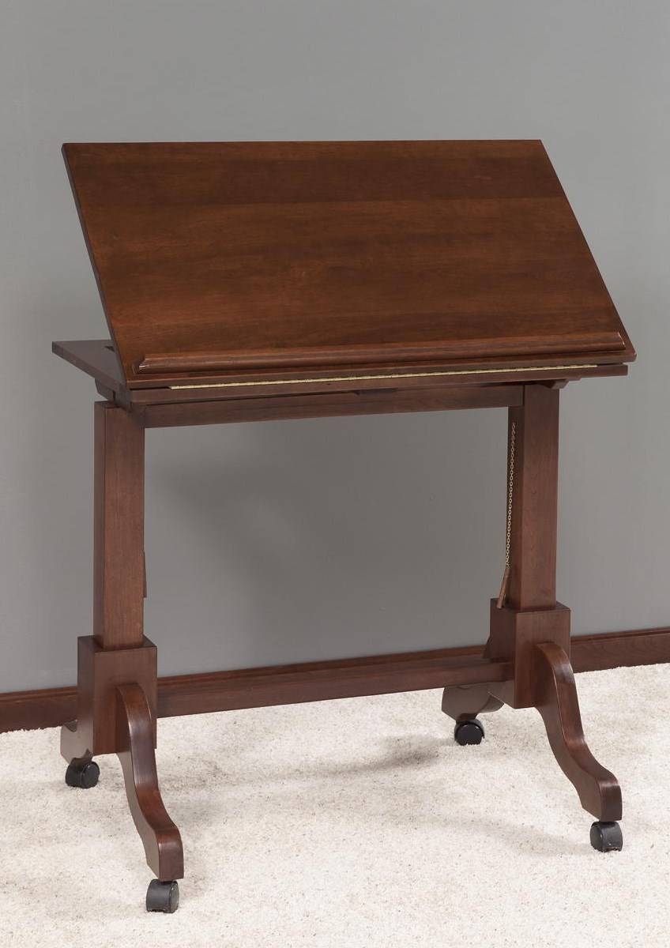

Slide 28
Generated the implicit chemical ontology of GO - GOChe

Slide 29
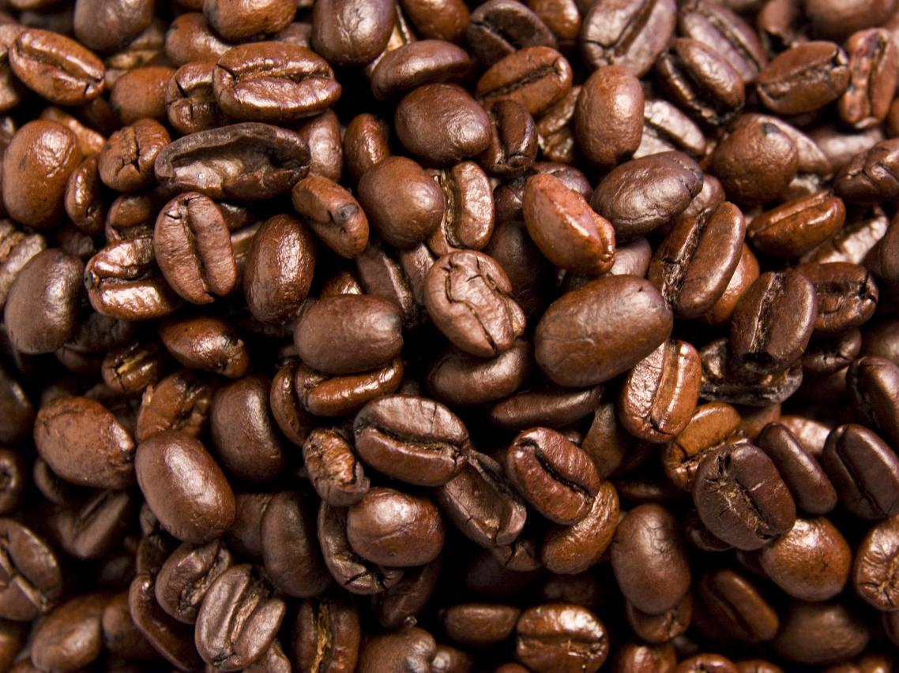
Four of us sat in a room for a weekend with a large pot of coffee and edited GOChe
(March 2010)

Slide 31
One of the things we consistently noticed was that ChEBI classified nucleotides as carbohydrates
Notes:
We assumed this was wrong. After all as biologists

Slide 32
Called another meeting with ChEBI. Who confirmed that nucleotides are indeed carbohydrates.

Slide 33
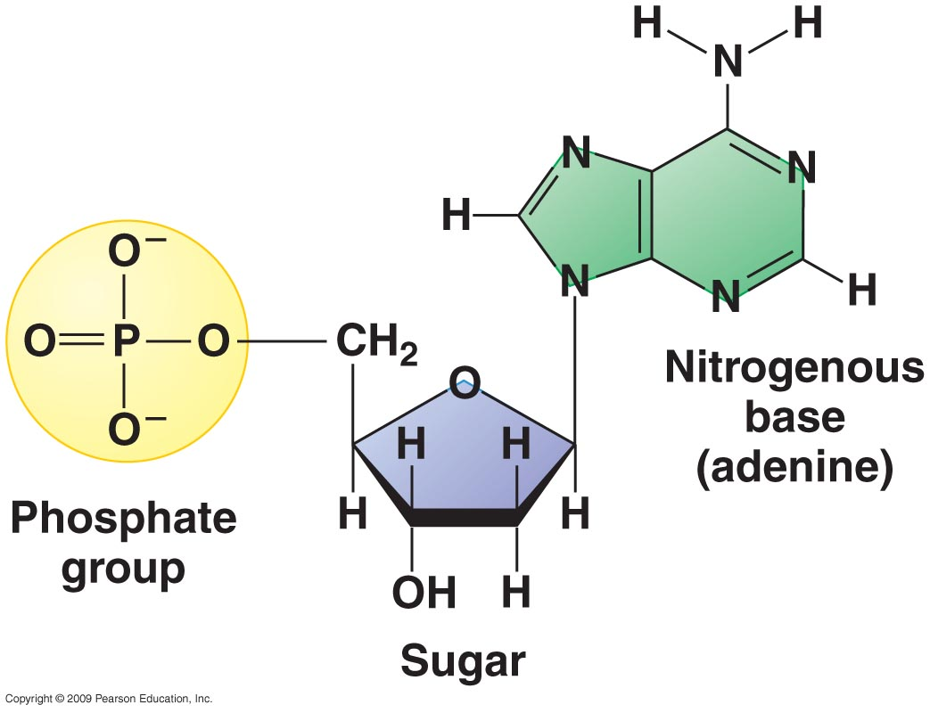

Slide 34
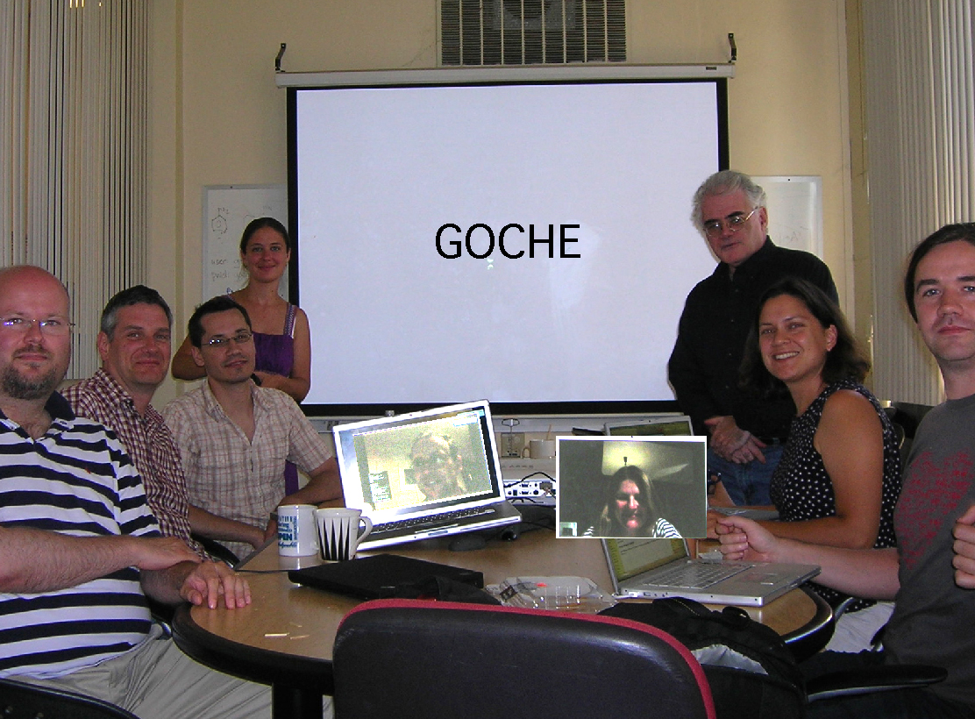

Slide 35
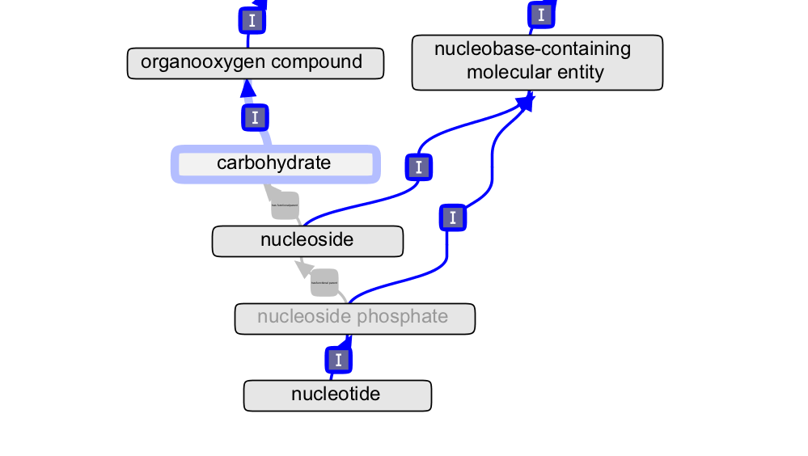

Slide 36
plurals e.g. pyridines v/s pyridine
“pyridine-containing compound”

Slide 37

Acids and bases
Acids and bases

Slide 38
Biologists are much more wooly and conflate these terms
  acids and bases often interconvert during biological processes

Slide 39
Union terms of acids and bases in GO:
carboxylic acid OR carboxylic acid anion
Notes:
Usually choose the anion to name the term

Slide 40
Where are we now?
Pretty much there
Bridging files between GO and CHEBI ready
Single update – use reasoner to ‘fix’ GO
Editing will involve loading both GO + CHEBI and reasoning
Paper ready for submission

Slide 41
What does this buy us?
Consistency and accuracy
Time savings
Potential for cool queries and analysis that combine biology and chemistry

Slide 42
People
David Hill
Jane Lomax
Harold Drabkin
Chris Mungall
Midori Harris
Tanya Berardini
Rebecca Foulger
Paola Roncaglia
Marcus Ennis
Paula de Matos
Janna Hastings
Nico Adams
Mike Bada
Colin Bachelor

