Slide 1
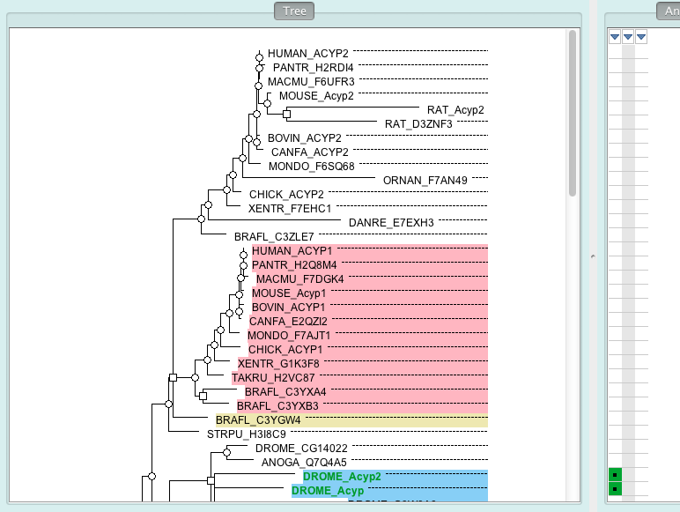
Example 1: ACYLPHOSPHATASE (PTHR10029)
vertebrate
ACYP2
vertebrate
ACYP1
duplication
in vertebrate
Notes:
92 proteins in this family.

Slide 2
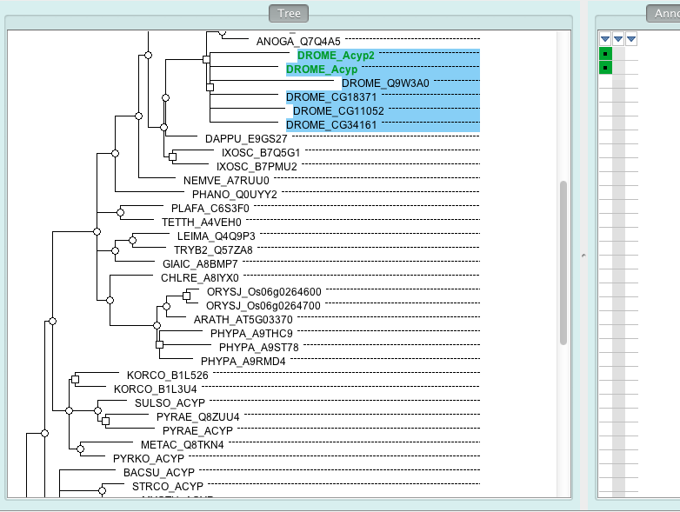
Example 1: ACYLPHOSPHATASE (PTHR10029)
insect
Protoza
green
plants
Archaea

Slide 3
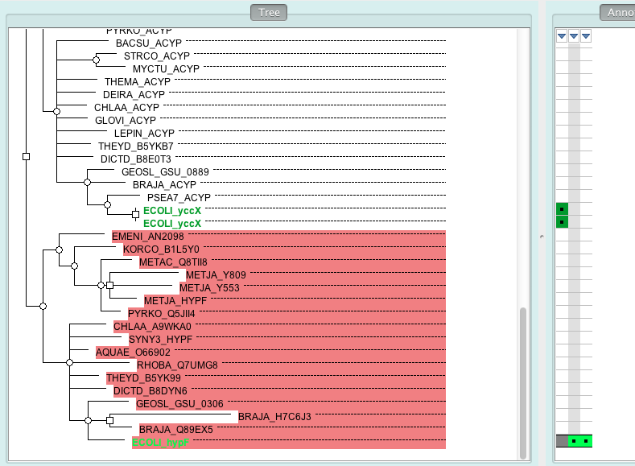
Example 1: ACYLPHOSPHATASE (PTHR10029)
Eubacteria
duplication
Archaea-
Eukaryota
Eubacteria

Slide 4
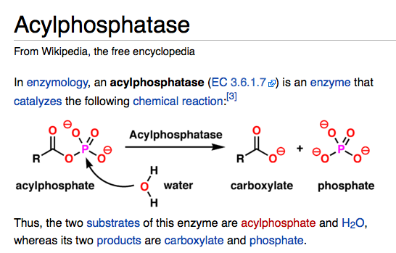
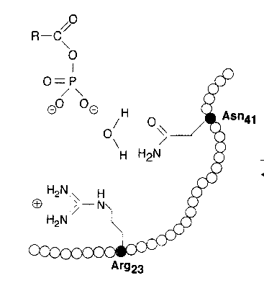
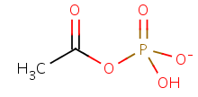
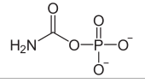
Example 1: ACYLPHOSPHATASE (PTHR10029)
R23 N41
PMID:9118002 (review)
substrates:
acetyl phosphate
carbamoyl phosphate

Slide 5
Example 1: ACYLPHOSPHATASE (PTHR10029)
HypF: hydrogenase maturation protein F
a zinc-containing protein involved in NiFe-hydrogenase maturation
acts as a carbamoyltransferase that transfers the carbamoyl moiety of carbamoyladenylate to the COOH-terminal cysteine of HypE (another hydrogenase maturation protein) [PMID:12586941].

Slide 6
Example 1: ACYLPHOSPHATASE (PTHR10029)
live demo
Molecular Function:
propagate 'acylphosphatase activity' to the Acyp clade. Those (in Acyp clade) missing either one of the two conserved residues (R23 N41) are annotated to NOT 'acylphosphatase activity' (IKR, inferred from key residues).
propagate 'carboxyl- or carbamoyltransferase activity' to the hypF clade.
propagate 'zinc ion binding' to the hypF clade.
Biological Process:
propagate 'protein maturation' to the hypF clade.
propagate 'protein carbamoylation' to the hypF clade.
Did not propagate 'phosphate-containing compound metabolic process' (TAS annotations).
Cellular Component:
none propagated (annotation to mitochondrion in mouse is based on high throughput assay).
Annotation issues:
HypF is also shown to have carbamoyl-phosphate phosphatase activity [PMID:12377778]. This annotation is not in GO yet.

Slide 7
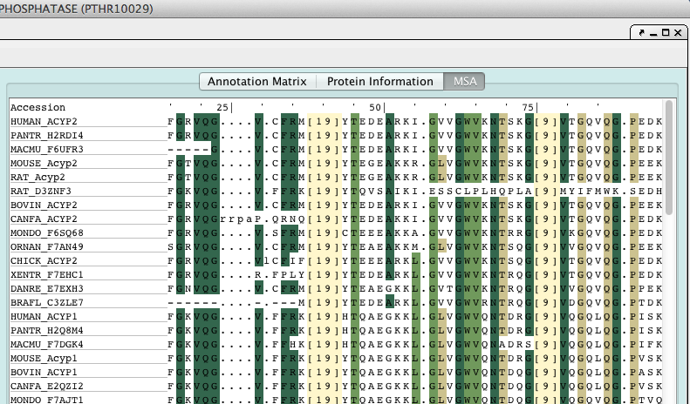
Example 1: ACYLPHOSPHATASE (PTHR10029)
R23
N41

Slide 8
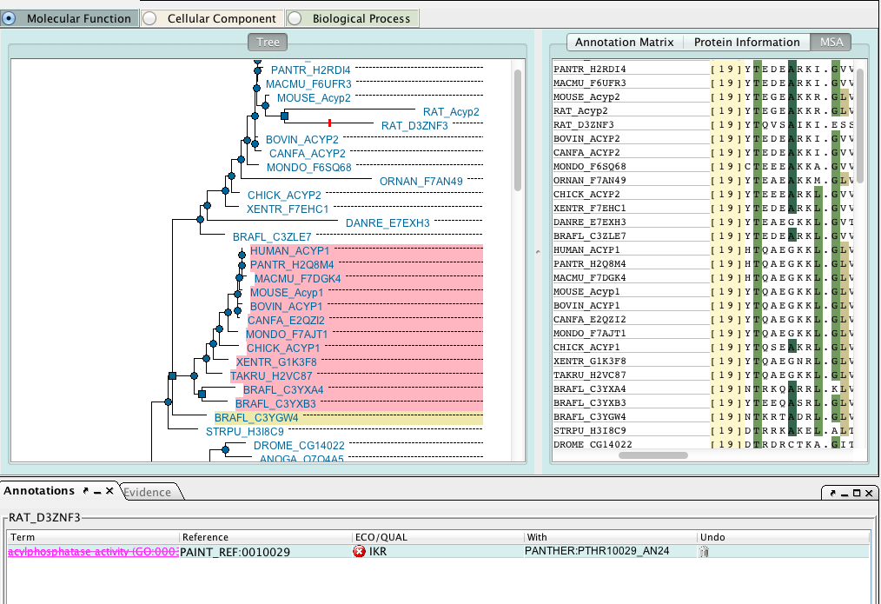
Example 1: ACYLPHOSPHATASE (PTHR10029)

