Slide 1

ClinVar
A system for maintaining medically relevant variation data
Donna Maglott, Ph.D
Senior Staff Scientist, NCBI

Slide 2
Why develop ClinVar?
Capacity for identification of human variation has increased
Not all variation is published in the literature
Evaluation and review is facilitated by centralization and standardization
Programmed access to data by sequence coordinates, in addition to text, is critical
Notes:
ClinVar is designed to facilitate access to published and unpublished sequence variation. Data are freely accessible, and records can be retrieved by text-based well as sequence-based searching.

Slide 3
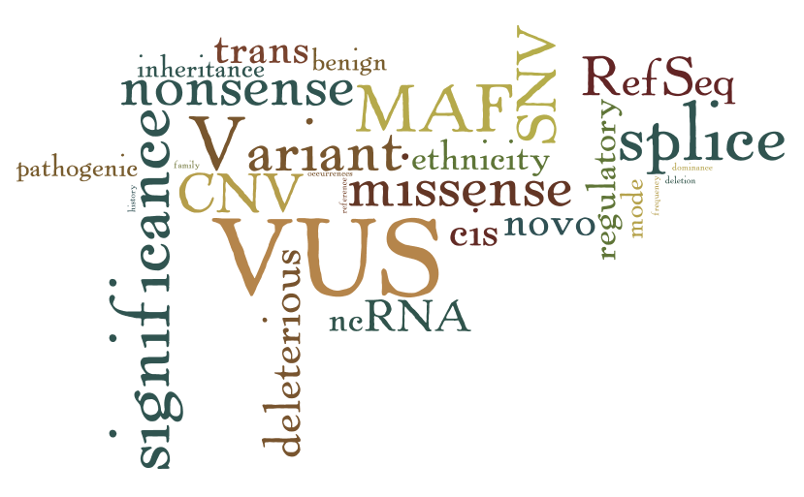
Why develop ClinVar?
Variant calls
Current interpretation
Notes:
There are many questions to be asked and variables to be considered between calling variations, and identifying enough about what has been reported about a variation to generate a reliable current interpretation.

Slide 4
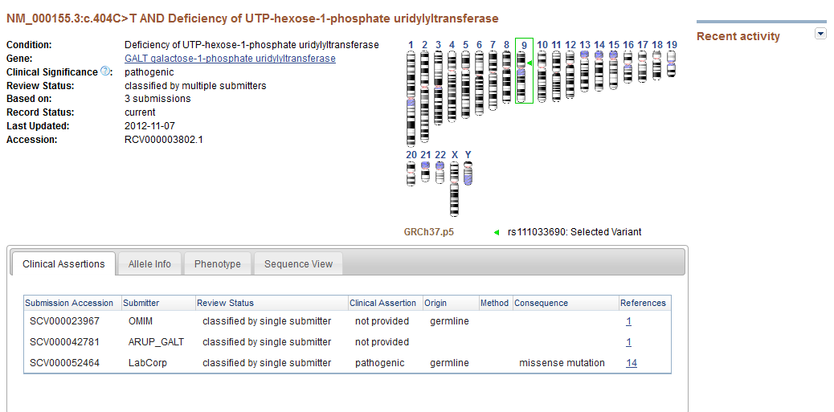
Why develop ClinVar?
Variant calls
Current interpretation
Notes:
ClinVar (screen shot of a preliminary report page) is designed to ease that path.

Slide 5
Why develop ClinVar at NCBI?
Integrate with dbSNP and dbVar and dbGaP
Integrate with Genomic Reference Consortium (GRC)
Integrate with NIH Genetic Testing Registry (GTR)
Integrate with variation analysis tools
And PubMed, Gene, MedGen, RefSeqGene, RefSeq…
Notes:
NCBI has multiple databases and established tools to support the information being accumulated around submissions to ClinVar. These include the databases that manage information about the locations of sequence variation (dbSNP for single nucleotide variations and length variations less than about 50 nucleotides) and dbVar for longer variations), dbGaP ( controlled access to variation associated with phenotype), tools to understand the current reference (GRC) and alternate assemblies of the human genome, the NIH Genetic Testing Registry (GTR), which maintains a voluntary registry of tests offered by laboratories doing genetic testing, and all the other databases NCBI has long offered such as PubMed, multiple sequence databases especially RefSeq, Gene, and NCBI’s new resource to manage phenotypic terms and information connected to those terms, namely MedGen.

Slide 6
What is ClinVar?
A central registry of variation observed in phenotyped individuals
A repository of the aggregate data necessary to (re)interpret the significance of that variation relative to a disorder
A versioned archive of interpretation of significance of single variants and combinations of variants
Freely accessible, curated and interpreted information layered on top of dbGaP, dbSNP, and dbVar
A bridge among terminology, publications, and the genome
A data distributor: browser/ftp/API
Notes:
ClinVar is a registry of data provided by submitters, connecting information about human variation observed in phenotyped individuals. ClinVar does not interpret the data, other than to calculate the molecular consequence of a sequence change at a particular location (e.g. missense, nonsense) , but processing will be done to standardize terminology and report of location of the variation in multiple sequence coordinate systems. Submitters own their data, and are encouraged to update their records as new data accumulate or interpretations change. In that case, a new version is assigned.
ClinVar will also calculate connections among records in the database, other databases at NCBI, and external databases.
Data in ClinVar is available without restriction by multiple mechanisms, including a website, ftp files, and automated programming interfaces (API).

Slide 7
Data Elements
Variation
Alleles as submitted, but converted to HGVS to report as differences relative to reference nucleotide sequences
Allele frequencies
Identifiers in dbSNP and dbVar
Identifiers from submitting databases (e.g. OMIM, LSDB, PharmGKB)
Official and alternate names
Genomic location (mapped to new genome assemblies as required)
Phenotype
Specificity: measured traits->specific diagnostic names-> indications for testing
Qualifiers: age of onset, age of observation
Terminology: Terms integrated from multiple authorities, grouped in concepts based on Unified Medical Language System® (UMLS®) with supplements such as the Human Phenotype Ontology (HPO).
Consolidated as identifier in MedGen
Notes:
The next few slides provide an overview of the types of information ClinVar is structured to manage. For full details of ClinVar’s data dictionary, please review the documentation on ClinVar’s ftp site and help documents on the website.

Slide 8
Data Elements
Evidence
Study elements: sample size, family structure, ethnicity, methods for data capture, methods for data analysis, animal models, heritability, tissues sampled
Observations: number of occurrences , with co-occurrences
Primary data or a meta-analysis
Interpretation
For alleles being assessed in a genetic model: Pathogenicity in the context of mode of inheritance and maternal/paternal origin
Risk / predisposition
Molecular consequence (missense/nonsense/splice site)
Functional consequence (loss of function/gain of function/dominant negative)
Date last evaluated
Validation level: from single study , multiple studies, to practice guideline

Slide 9
Data flows
Testing laboratories,
LSDB,
Authors…
Expert review
Novel variations submitted to ClinVar will be submitted to dbSNP/dbVar
ClinVar
ClinVar provides a layer of submitted interpretation not provided by dbSNP/dbVar
dbSNP
<~50 bp
dbGaP
dbVar
(>~50 bp
NCBI
Notes:
ClinVar is structured to exchange data with other variation and phenotype-specific resources within NCBI as well as external databases.

Slide 10
Review of ClinVar records
Expert review
Review by domain experts is facilitated by accessing information from ClinVar
Result of the review accessioned for reporting from ClinVar
ClinVar
Notes:
ClinVar does not provide the expert review, but serves as a data feed to groups reviewing evidence, and a repository for the results of that review.

Slide 11
Accessions and versions maintain
historical interpretations per submitter
Accession.version | Example
SCV000000001.1 | Submitter A reports NM_000000.1:c.5A>C is pathogenic for condition A
SCV000000002.1 | Submitter B reports NM_000000.1:c.5A>C is a variation of unknown significance for condition A
SCV000000002.2 | Submitter B provides an update, now reporting that NM_000000.1:c.5A>C is benign with respect to condition A
Aggregation by NCBI or submitters
RCV000000001.1 | Combines data from SCV000000001.1 and SCV000000002.2, indicating that reports of clinical significance are not consistent
RCV000000002.1 | Authoritative group evaluates all evidence and provides the consensus report of the clinical significance of NM_000000.1:c5A>C for condition A
Notes:
This slide summarizes how ClinVar assigns accessions and versions.
There are two types of accessions assigned by ClinVar. The type beginning with SCV represents what the submitter provided. The unit record is the (set of) variations observed in a set of individuals with the same phenotype, with an optional interpretation of the clinical significance. The set of variations is not the complete genotype of the individual, but rather the alleles, because of their rarity and gene association, are being interpreted for relationship to a phenotype.
The RCV accession is an aggregate based on the set of submitters’ accessions (SCV) with the same set of phenotypes and alleles. The RCV accession can either be generated by NCBI, when NCBI aggregates data from multiple groups, or by a submitter that represented an authoritative body submitting practice guidelines.

Slide 12
Accessing the data

Slide 13
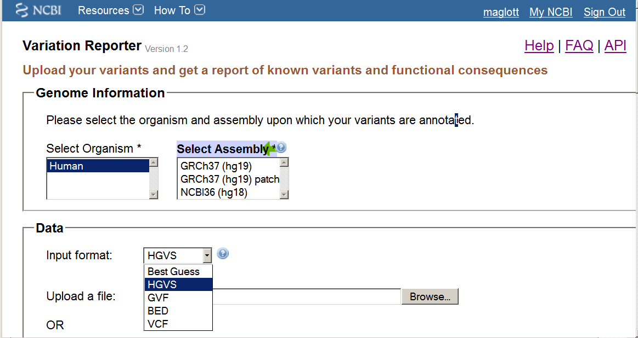
Accessing ClinVar via Variation Reporter
Select the assembly
Upload a file or paste into a box
http://www.ncbi.nlm.nih.gov/variation/tools/reporter/
Notes:
Data in ClinVar is used in, and can be accessed by, multiple tools at NCBI. One is Variation Reporter, which allows you to upload a file of variant calls (VCF, GVF, BED, HGVS) and generate a downloadable report of what might be known about those locations on the genome, and, if a sequence change is reported, the molecular consequence of that allele.

Slide 14
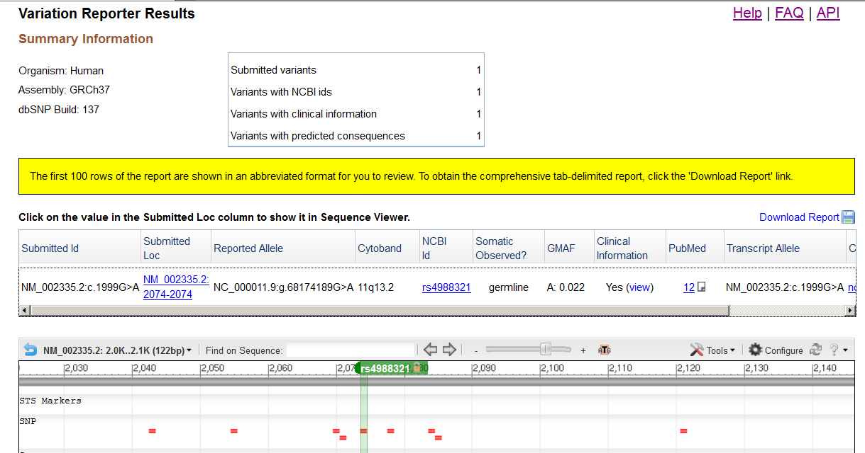
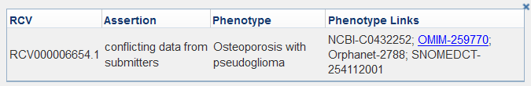
http://www.ncbi.nlm.nih.gov/variation/tools/reporter/
Processing summary
Notes:
Links to Help documents, FAQ, and an API are provided at the upper right. If there is a report that there are submissions in this dataset from ClinVar, you can see the data in the download, or click on Yes to see a popup like this summarizing the phenotype (in this case a diagnosis) and links to databases within NCBI and external to NCBI.

Slide 15
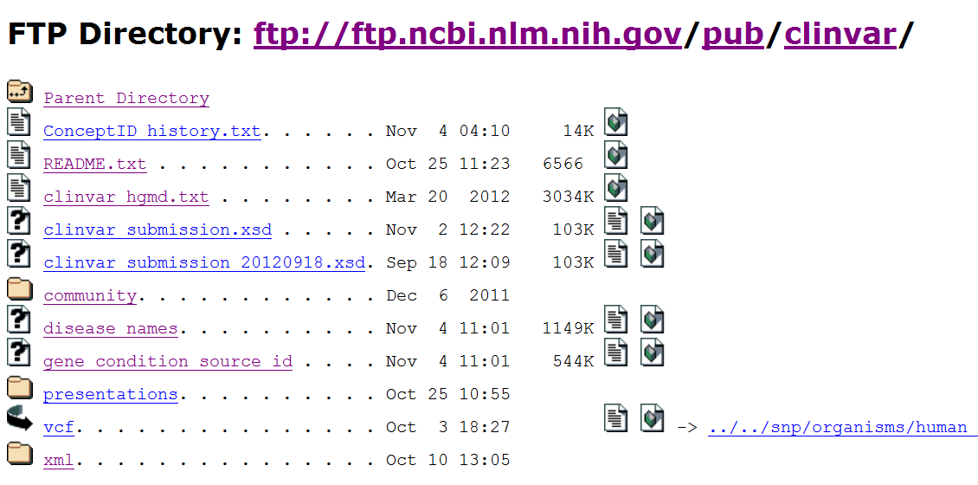
Accessing ClinVar data by ftp
Notes:
There is a link from ClinVar to vcf files for the subset of data in ClinVar that is linked to data in dbSNP. There is a backlog of data in ClinVar that has not yet been mapped to nucleotide sequence coordinates; these will not be reported in the vcf file.

Slide 16
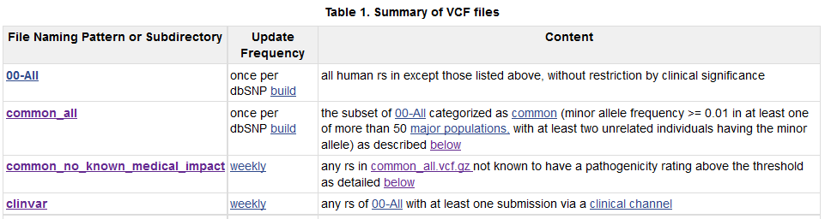
vcf files
www.ncbi.nlm.nih.gov/variation/docs/human_variation_vcf
ClinVar subset updated weekly
Common alleles with no known clinical significance
Common alleles with clinical significance
Variations submitted from groups with clinical interest (clinical channel)
Notes:
The path at the top of the slide is the source of documentation describing the vcf files. These files are designed to help filter out common variation that is not known to be associated with a phenotype (common_no_known_medical_impact) as well as provide a report of the variation in ClinVar, pathogenic or not, that has been assigned rs numbers (clinvar).

Slide 17
Accessing ClinVar data by ftp
XML
Monthly extraction of the database
Comprehensive weekly updates

Slide 18
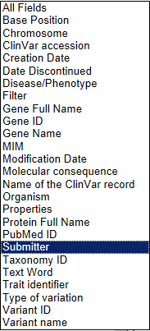
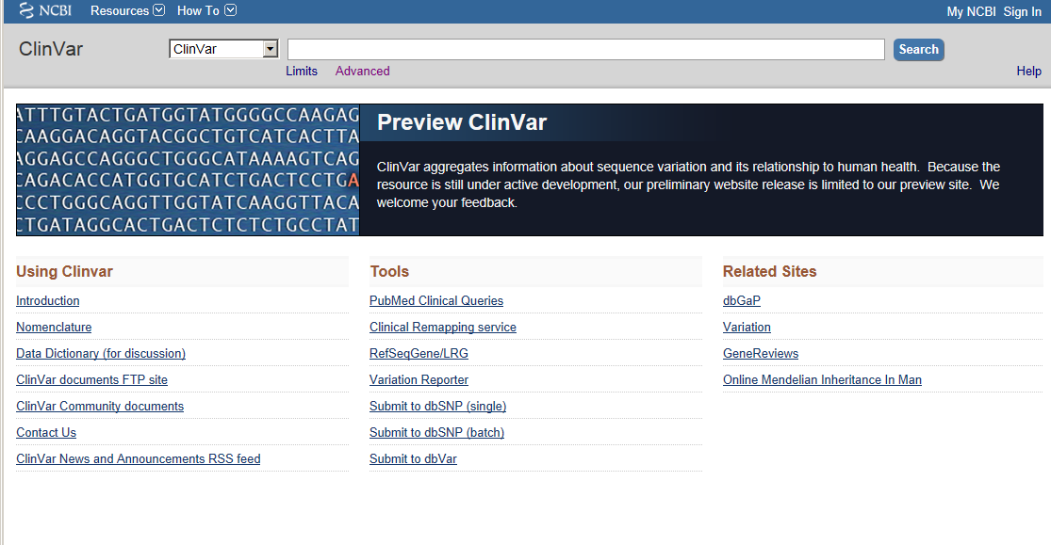
Accessing ClinVar by browsing
http://preview.ncbi.nlm.nih.gov/clinvar
Notes:
ClinVar is currently searchable by multiple fields at the preview site.

Slide 19
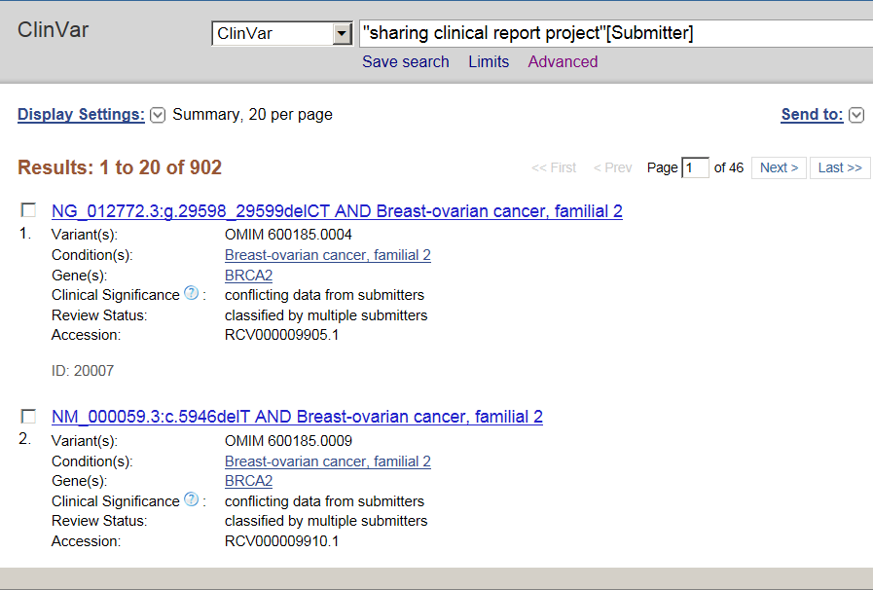
Data from SCRP
Query by submitter
902 results
Notes:
A sample query for data from one submitter, in this case the ‘sharing clinical report project’ SCRP. Some of these data overlap with data in ClinVar based on allelic variations in OMIM. In this case, the interpretation in the RCV accession is reported as conflicting, because according to the rules provided by OMIM, their records are treated as ‘risk factors’ not ‘pathogenic’ It is this type of conflict in reporting that needs review.

Slide 20
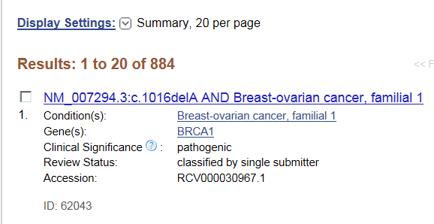
Data only from SCRP
Notes:
An expanded result showing the summary data that are included in the result set. Plans are underway to report this as a table, and to add the latest date the significance was reviewed.

Slide 21
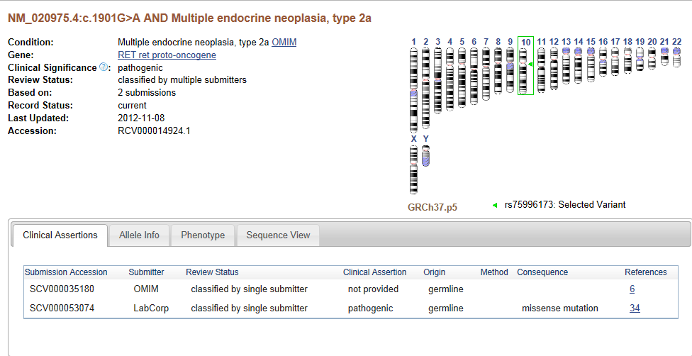
Current detailed display
Overview information provided in a tabbed format
Notes:
The current record-specific overview includes a genome view, indicating the location of the variation, and summary data about each submission. An ‘Evidence’ tab will be added shortly, summarizing the observations from all submitters.
A submission-specific full display will also be provided, based on clicking on the SCV accession (e.g. in this case SCV00000035180)

Slide 22
We thank our submitters!
Testing laboratories | Number of variations | Curated /Published Sources | Number of Genes
Ambry | 10 | ClinSeq | 36
ARUP | 1328 | GeneReviews | 238
Correlagen/LabCorp | 955 | LSDB | 83
Dana Farber | 382 | NCBI (partial) | 42
ISCA (nstd37) | 1167 | OMIM | 2061
Partners Health Care/Harvard | 590 | UniProtKB | 27
SCRP (BRCA1/BRCA2) | 902

Slide 23
Acknowledgements
ClinVar/GTR staff | dbSNP/dbVar
Alex Astashyn Shanmuga Chitipiralla Vichet Hem Douglas Hoffman Wonhee Jang Brandi Kattmann Ken Katz Melissa Landrum Jennifer Lee Adriana Malheiro Michael Ovetsky George Riley Wendy Rubinstein Ray Tully Ricardo Villamarin George Zhou | Deanna Church John Garner Tim Hefferon John Lopez Rama Maiti Lon Phan David Shao Ming Ward
 | Submitters
 | Ambry ARUP BIC ClinSeq Correlagen/LabCorp Partners Health Care GeneReviews/LSDB/UniProtKB

Slide 24
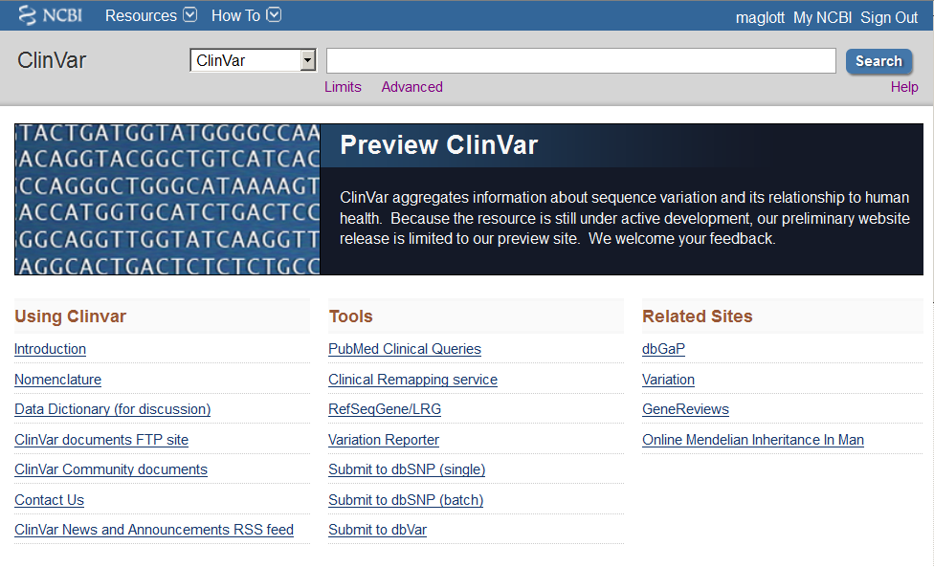
Try it and give us your feedback
preview.ncbi.nlm.nih.gov/clinvar/
www.ncbi.nlm.nih.gov/clinvar/
www.ncbi.nlm.nih.gov/variation/tools/reporter/
www.ncbi.nlm.nih.gov/medgen/

